Slide 1
Planning & Zoning Commission Vs. Zoning Board of Adjustment
Presented by: Megan Santee, Senior Attorney
DNRBZ I AUS

Slide 2
Similarities
Created under LGC 211
Appointed by Council
Authority over regulatory processes
Any decision may be appealed

Slide 3
Planning & Zoning Commission
Performs advisory functions
Develops a comprehensive zoning plan
Reviews and reports on amendments to zoning
Focus is usually on large scale planning issues

Slide 4
P&Z Commission
Serves at the will of the City Council with limited powers General Law municipality may have a zoning commission – LGC Section 211.007
Act as an advisory group to the City Council in required and discretionary functions
Comprehensive planning
Zoning
Platting
Other growth management initiatives related to the physical development of the city.
Appointment and Removal at discretion of Council
Subject to TOMA

Slide 5
Comprehensive Plan and its Impact LGC Sections 213.001 et. al. & 211.004
City is not required to have a comprehensive plan in order to zone;
HOWEVER….
If a city adopts a comprehensive plan it must be followed when making zoning decisions. LGC § 211.004(a)

Slide 6
Zoning LGC Sections 211.001 et. al.
Zoning Applications – new or annexed
Rezoning Applications
Conditional Use Permits/Special Use Permits
Beware – exclusionary, regulatory, constitutional challenges

Slide 7
Platting LGC Sections 212.001 et. al.
Adoption of Subdivision Regulations:
After a Public Hearing on the matter cities may adopt rules governing plats and subdivisions of land within the municipality’s jurisdiction to promote the health, safety, morals, or general welfare of the municipality and the safe, orderly, and healthful development of the city.
Tex. Loc. Gov’t Code § 212.002
Can be final in this matter

Slide 8
Other Advisory Functions LGC Sections 211.001 et. al.
Regulatory or text amendment
A public hearing is held to receive input from the public
Notice is required to be published in a newspaper of general circulation and on the meeting agenda.
New Austin Case – March 17, 2022 - City of Austin v. Acuna, regarding notice to property owners (a comprehensive revision “changes” existing zoning ordinances, and thus, the statute’s written-notice and protest provisions apply).
Can conduct land-use inventories, determine preliminary land-use goals and policies, formulate specific district regulations, and draw tentative district boundary lines.

Slide 9
What Commission CAN do
Approve
Recommend approval of applications with conditions
Approve
Recommend approval of a use permit with conditions
Approve
Recommendations to Council on any item other than platting (if final authority)

Slide 10
What Commission CANNOT do
Approve
Recommend approval of a more intense zoning district
Approve
Recommend approval of a use permit for individual named business
Deny
Plat that meets all of the requirements

Slide 11
Zoning is Discretionary

Slide 12
Zoning Board of Adjustment
More of an action agency
Deals with issues on a tract-by-tract basis
Quasi - judicial

Slide 13
Zoning Board of Adjustment
City may create
Must be board separate from City Council in Home Rule City

Slide 14
Zoning Board of Adjustment
LGC Sections 211.0075-211.011
Five members
Two-year terms
City Council determines appointment procedure
Removal only for cause
Subject to TOMA

Slide 15
Zoning Board of Adjustment
LGC Sections 211.008-211.011
Alternate members may be appointed to serve in the absence of one or more regular members when requested by the mayor or city manger (by ordinance)
Each case must be heard by at least 75% of the members
All meetings of the board shall be open to the public.

Slide 16
Zoning Board of Adjustment
LGC Sections 211.008-211.011
The board by majority vote shall adopt rules in accordance with any ordinance adopted under this subchapter and with the approval of the governing body.
The presiding officer or acting presiding officer may administer oaths and compel the attendance of witnesses.
Concurring vote of 75% to reverse, decide in favor of or authorize a variation from

Slide 17
Zoning Board of Adjustment
LGC Sections 211.008-211.011
The board shall keep minutes of its proceedings that indicate the vote of each member on each question or the fact that a member is absent or fails to vote.
The board shall keep records of its examinations and other official actions.
The minutes and records shall be filed immediately in the board’s office and are public records.

Slide 18
Zoning Board of Adjustment
LGC Sections 211.008-211.011
Decide appeals from a decision of an administrative official regarding the Zoning Ordinance
May reverse, affirm, or modify an administrative official's order, requirement, or decision
Authorize a variance if:
public interest is served;
substantial justice is achieved; and
unnecessary hardship would otherwise result
Hear and decide special exceptions to the terms of a zoning ordinance when the ordinance requires the board to do so;
Decide other matters authorized by ordinance under Chapter 211 Subchapter A

Slide 19
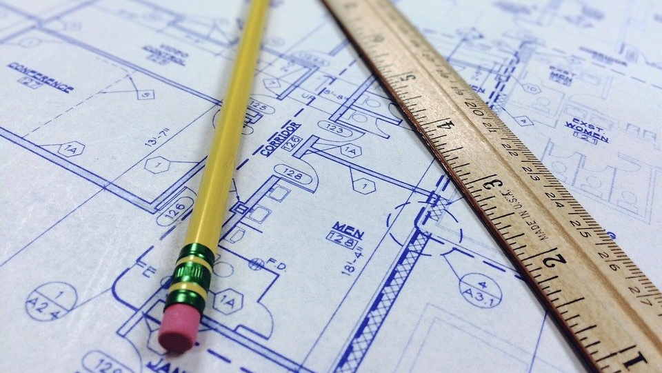
Rules of Procedure

Slide 20
Rules of Procedure
Preface
Purpose and Scope
Election of Officers
Presiding Officer, Secretary
Minutes and Records
Meetings
Voting
Application Forms
Time Limit to Submit an Appeal
Hearing Required
Deliberation, Voting, and Findings
Filing of Board Decisions
Prohibition on Ex Parte Communications
Limitations on Authority of Zoning Board of Adjustment

Slide 21
By-Laws

Slide 22
By-Laws and Procedures
The Board and Selection of Officers
Presiding Officer, Secretary, Legal Counsel, Minutes and Records
Consultants and Volunteer Assistance
Quorum and Absences
Meetings
Public Comment
Motions and Discussions
Voting on Motions
Reconsideration of Decisions
Conflicts of Interest
Staff Reports Required
Public Statements
Amendments to By-Laws
Rules of Procedure or Conduct

Slide 23
What Board of Adjustments CAN do
Grant variance that will:
Not be contrary to public interest
Where due to special conditions literal enforcement would result in unnecessary hardship
So that the spirit of the ordinance is observed, and substantial justice is done
Board of Adjustments is the escape valve for the Zoning Ordinance when land does not fit ordinance mold

Slide 24
What Board of Adjustments CANNOT do
Grant
Grant a “use” variance
Grant
Grant an increase to the variance requested
Overturn
Overturn a staff decision, authorize a variance from the zoning ordinance, or approve an applicant’s request with less than 75% of the affirmative votes of the members

Slide 25
Practical Tips
Be cautious – don’t speed up the process.
1
Treat all applicants fairly.
2
Make proper findings or report
3
Frame comments in objective terms.
4
Be attentive!
5

Slide 26
Questions?
Megan R. Santee mrsantee@rampagelaw.com
Denton Navarro Rocha Bernal & Zech, P.C. 2500 W. William Cannon Drive, Suite 609 Austin, Texas 78745
(512) 279-6431
www.rampagelaw.com

