Slide 1
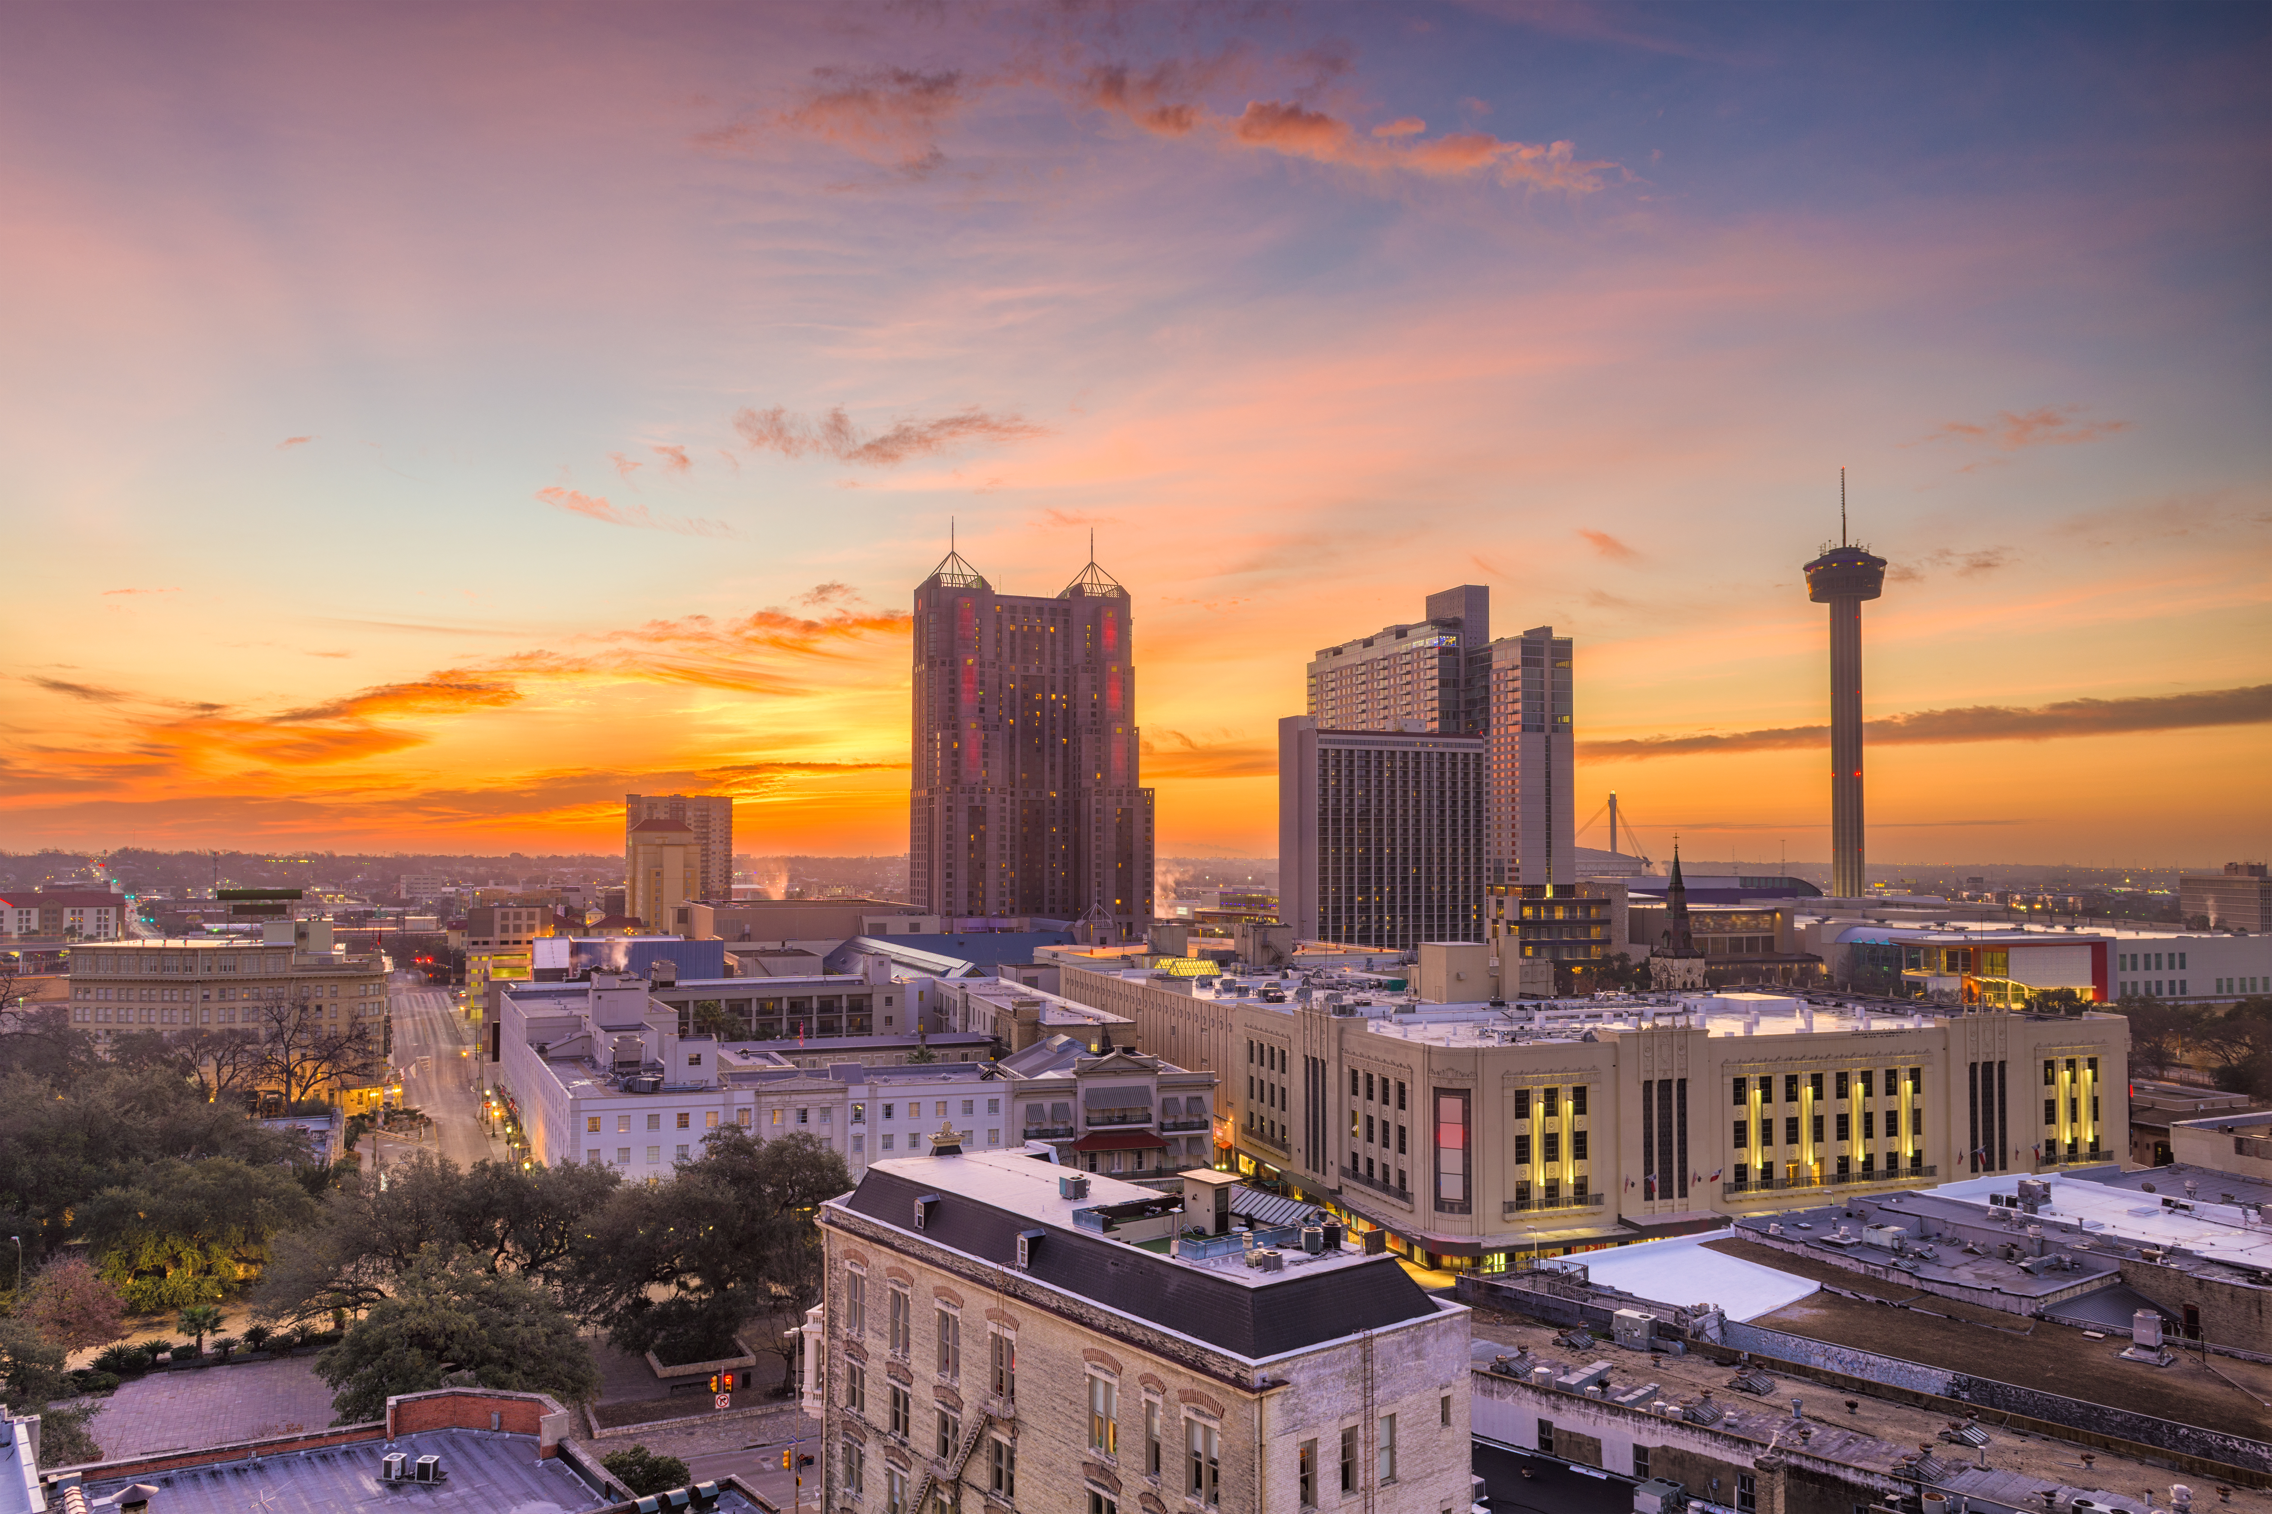
Texas Community Development Block Grant (TxCDBG)
2022-2023
Project Priorities for Alamo Region
Rick Bluntzer
Senior Director of Operations

Slide 2
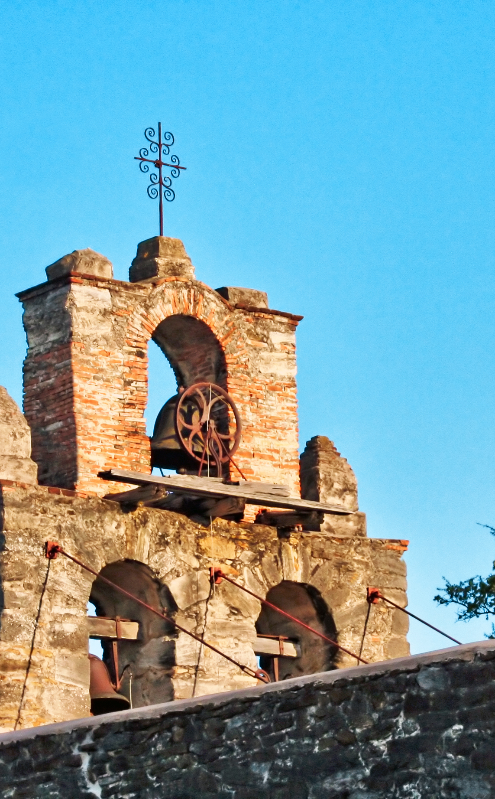
Where to Send Comments During Meeting
Purpose of Meeting
Eligibility Criteria
Past Project Priorities and Grant Recipients
Public Comments on Project Priorities
Next Steps
Welcome / Agenda

Slide 3
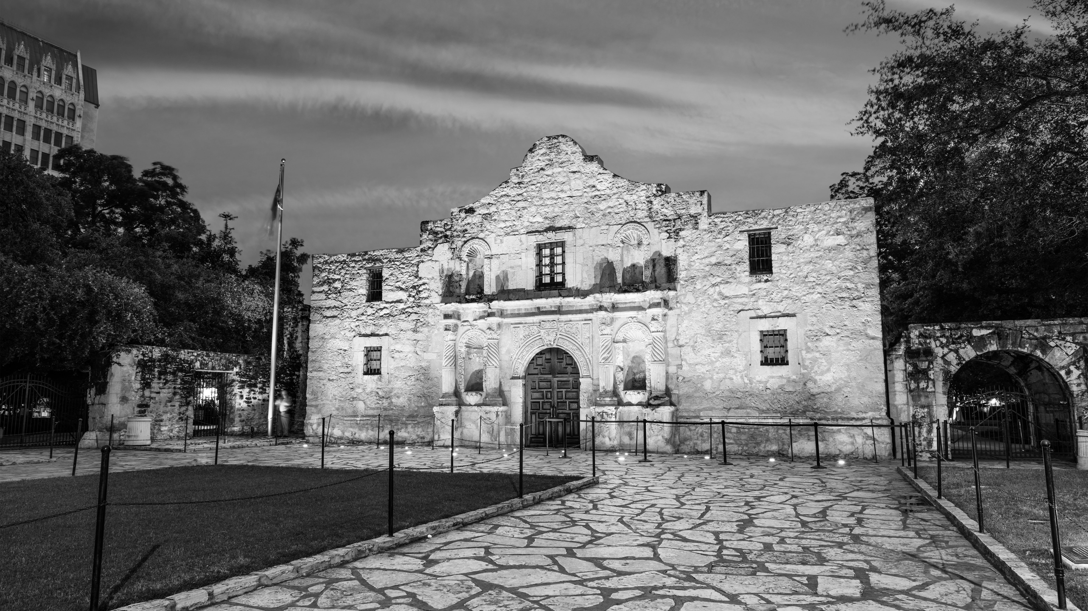
Where to Send Comments:
Comments during the meeting can be made by calling (210) 362-5243 or by emailing sduff@aacog.com
Comments after today’s meeting must be sent to sduff@aacog.com by 9:00 a.m. on June 15th

Slide 4

Purpose of Meeting
Purpose: Select Project Priorities for the Alamo Region for the 2022-2023 Program Year.
Comments from the public and communities in the region are welcome and will help develop the Project Priorities.

Slide 5
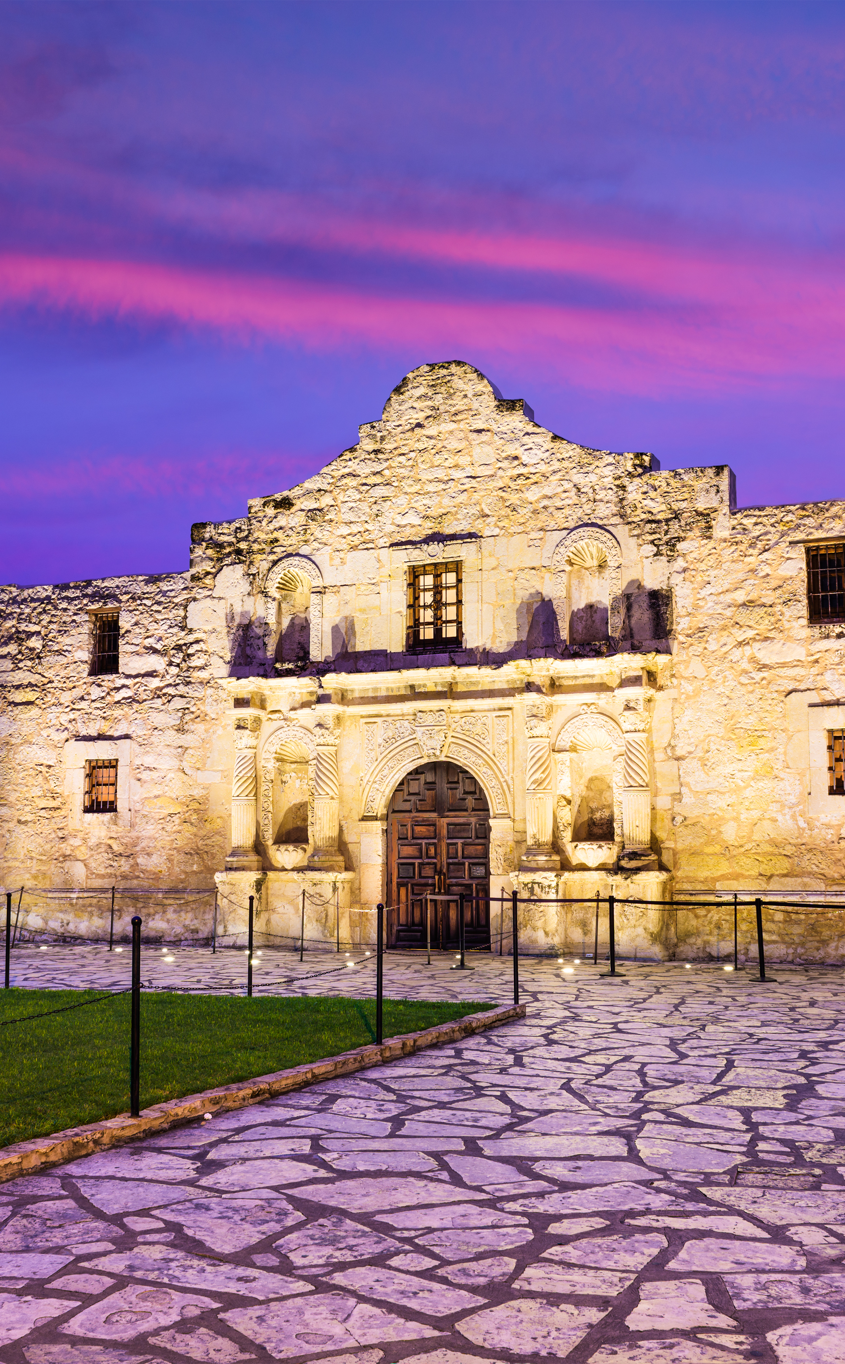
Eligibility Criteria
Non-entitlement community – A rural city with a population that is less than 50,000, or a county that has a non-metropolitan population under 200,000 and is therefore not eligible for direct funding from U.S. Department of Housing and Urban Development (HUD).
Other Factors – At least 51% of the persons who would directly benefit from the project and target area proposed in the application must be low to moderate income not to exceed 80% of the median income of the area involved, as determined by HUD.

Slide 6
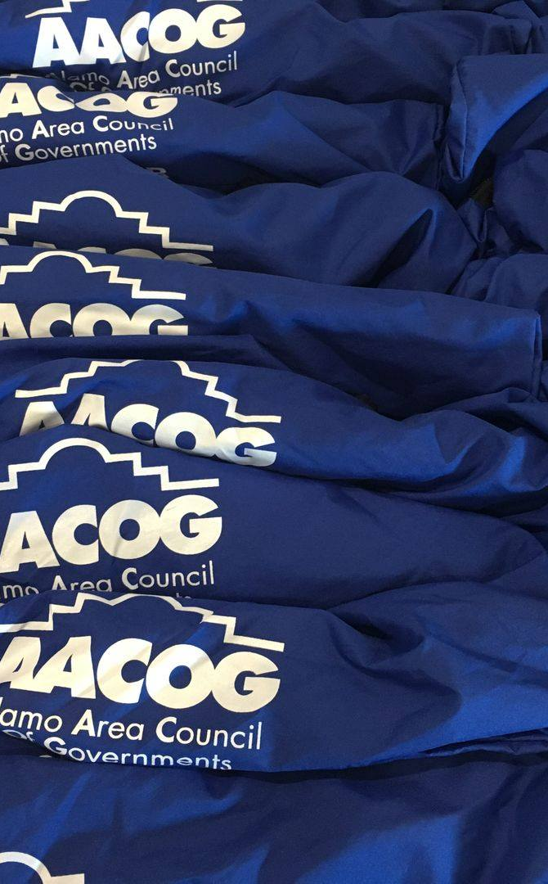
Eligible Communities
Atascosa County
Pleasanton
Poteet
Jourdanton
Lytle
Charlotte
Christine
Bandera County
Bandera
Comal County
Frio County
Dilley
Pearsall
Gillespie County
Frdericksburg
Guadalupe County
Marion
Santa Clara
Seguin
Karnes County
Falls City
Karnes City
Kenedy
Runge
Kendall County
Boerne
Kerr County
Ingram
Kerrville
McMullen County
Medina County
Castroville
Devine
Hondo
La Coste
Natalia
Wilson
Floresville
La Vernia
Poth
Stockdale

Slide 7
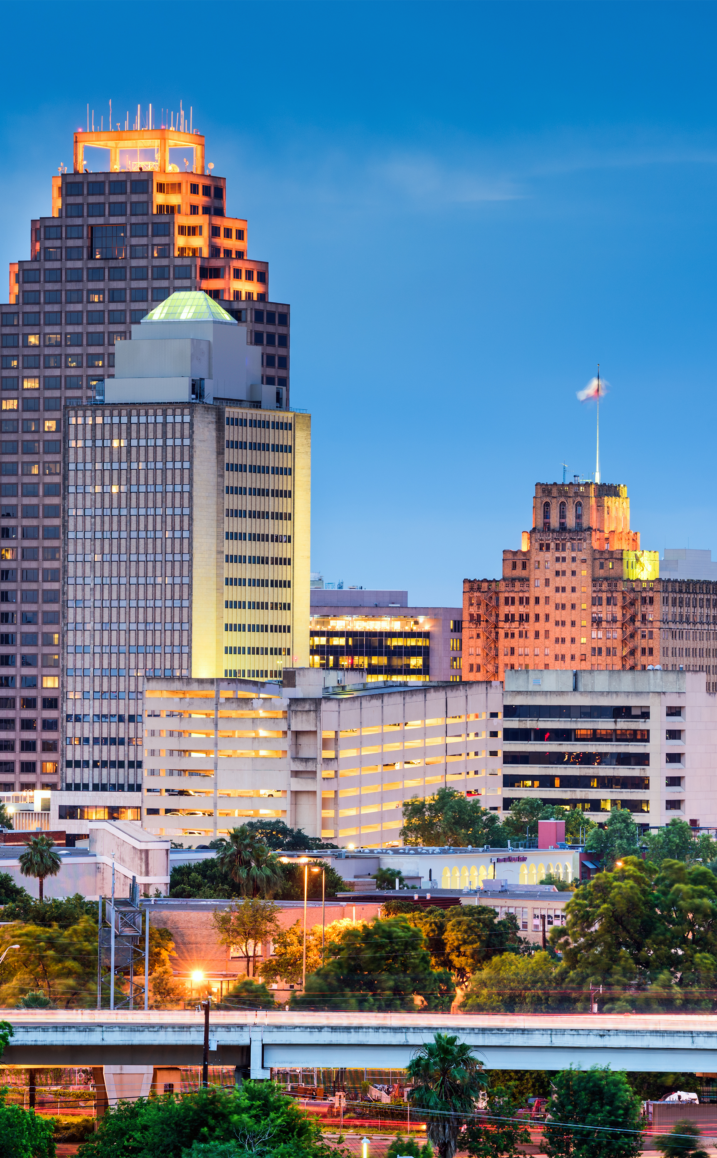
Past Project Priorities: 2021-2022
First Priority Project Types:
Water / Wastewater
Septic tanks
First-time service water / wastewater yard lines
Second Project Priority Types:
Roads / Streets
Drainage

Slide 8
2021 – 2022 Grant Recipients
Region Allocation: $3.5 Million
Grants Awarded: 10
Award Amount Per Grantee: $350,000
Bandera County City of Kerrville
Karnes County City of La Coste
City of Falls City City of Marion
City of Hondo City of Pleasanton
City of Karnes City City of Sandy Oaks

Slide 9
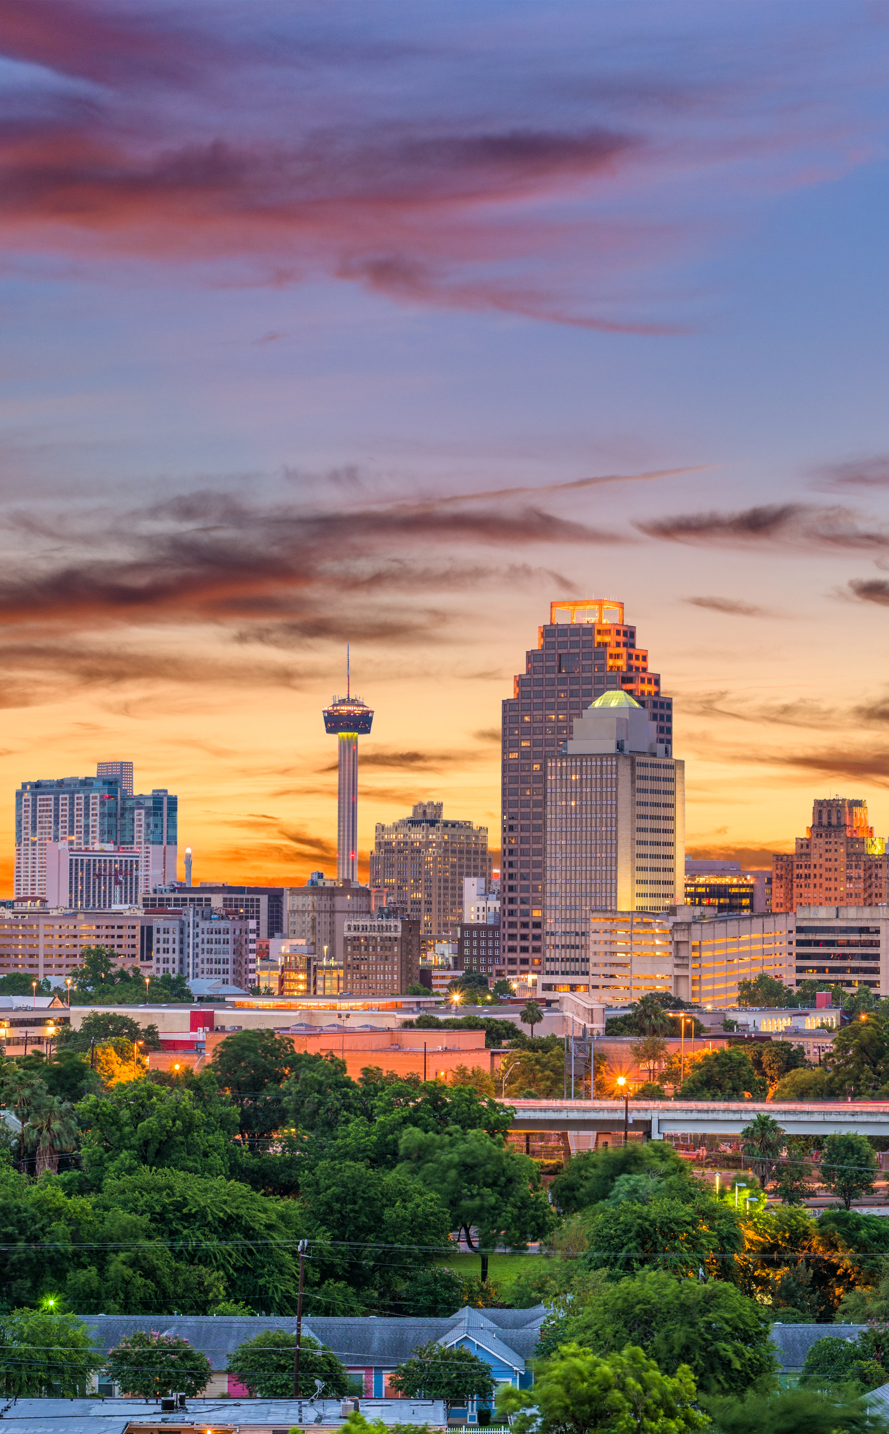
Public Comments
Audience welcome to present comments in-person
Email Comments: sduff@aacog.com

Slide 10
Next Steps
These comments will be compiled and presented to the AACOG Board of Directors on Wednesday, June 22nd, for their consideration, before submitting to Texas Department of Agriculture on or before July 1, 2022.

Slide 11
Thank you for attending.
Send Additional Comments to:
sduff@aacog.com
By 9:00 a.m., June 15th

