Slide 1
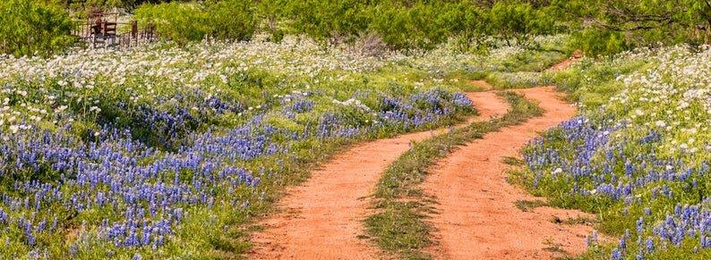
AACOG Method of Distribution (MOD) Amendment Hurricane Harvey CDBG-Disaster Recovery
December 21, 2022

Slide 2
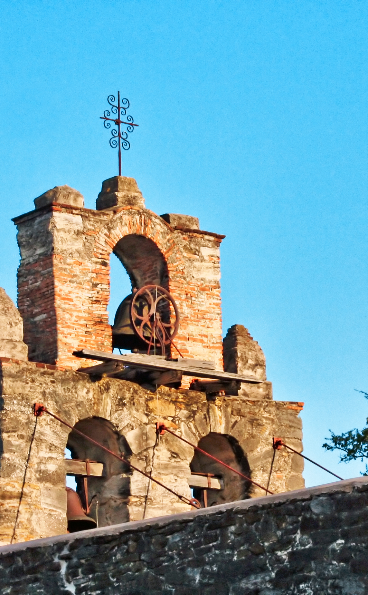
AACOG is amending its Local Infrastructure Program MOD to reallocate declined and/or de-obligated funds over $100,000.00 from its initial Local Infrastructure Program MOD.
$1,317,225.00 was declined by 2 counties (Comal and Guadalupe) and 3 communities (New Braunfels, Schertz, Seguin) in the AACOG region. These entities are ineligible to receive allocations through the MOD amendment. The funds will be reallocated based on the MOD Amendment.
AACOG MOD Amendment: Hurricane Harvey CDBG-Disaster Recovery
Local Infrastructure Program

Slide 3
2018 AACOG MOD: Hurricane Harvey
CDBG-Disaster Recovery
2018 Local Infrastructure Allocation = $1,530,000
Estimated $292,775 used
2018 Distribution Factors
Damage Reports = 50%
Population = 25%
Repeat Disaster = 25%
Alamo Area Council of Governments

Slide 4
AACOG MOD Amendment: Hurricane Harvey CDBG-Disaster Recovery
2022 Amendment Local Infrastructure Allocation = $1,317,225
2022 Amendment Local Infrastructure Minimum Grant
Minimum grant of $100,000
70% of the funds must benefit Low-to-Moderate Income (LMI)
2022 Amendment Distribution Factors
Low-to-Moderate Income = 50%
Social Vulnerability (SoVI) = 25%
Population = 25%
Alamo Area Council of Governments

Slide 5
AACOG MOD Amendment: Hurricane Harvey CDBG-Disaster Recovery
Required | Local Infrastructure Program
 | Required | Required | Required | Required | Required | Required
City or County | HUD MID or State MID | Initial Allocation | Change | Amended Allocation | Percentage of Allocation | 70% Low-to-Moderate Income Benefit Requirement
Karnes County | State MID | $ 74,177.00 | $423,516.00 | $ 497,693 | 31.22% | $ 348,385.10
Bulverde/Spring Branch | State MID | $ 61,528.00 | $114,277.00 | $ 175,805 | 11.03% | $ 123,063.50
Falls City | State MID | $ - | $106,459.00 | $ 106,459 | 6.68% | $ 74,521.30
Karnes City | State MID | $ 33,745.00 | $217,335.00 | $ 251,080 | 15.75% | $ 175,756.00
Kenedy | State MID | $ 50,853.00 | $195,457.00 | $ 246,310 | 15.45% | $ 172,417.00
Marion | State MID | $ 56,593.00 | $260,181.00 | $ 316,774 | 19.87% | $ 221,741.80
 | Total: | $276,896 | $1,317,225 | $1,594,121 | 100.00% | $1,115,885.00
Alamo Area Council of Governments

Slide 6
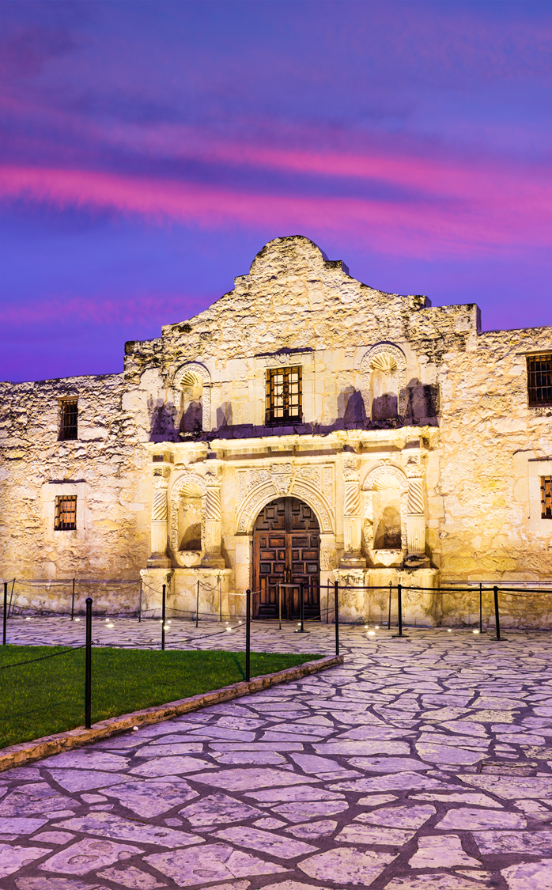
Eligible Activities
Flood control and drainage improvements, including the construction or rehabilitation of storm water management systems
Infrastructure improvements (such as water and sewer facilities, streets, provision of generators, removal of debris, bridges, etc.)
Demolition, rehabilitation of publicly or privately-owned commercial or industrial buildings, and code enforcement
Each infrastructure activity must demonstrate how it will contribute to the long-term recovery.

Slide 7
Ineligible Activities
Construction of dam/levee beyond original footprint
Government buildings (conduct of government business)
General government expenses to conduct business
Political activities
Purchase of construction equipment
Purchase of fire protection equipment
Purchase of personal property
Operating and maintenance expenses
New housing construction

Slide 8
AACOG Activity
2018: Developed MOD for Local Infrastructure Program
2022: Developed and submitted Community Participation Plan (CPP) for review and approval by GLO – November 3
  Public Planning Meeting (November 10)
  Public Hearing (December 21, Karnes County Courthouse)
2023: Receive public comments from December 16, 2022 through January 16, 2023
Alamo Area Council of Governments

Slide 9
Next Steps
Receive comments through noon on Monday, January 16, 2023
AACOG Board of Directors (BOD) approval of final MOD on January 25, 2023
Submission of MOD to GLO January 30
Issue of Allocation Letters
TxGLO approval of MOD
Alamo Area Council of Governments

Slide 10
Thank You For Your Time
Miguel Segura
Director of Public Affairs & Regional Development
Phone: 210-362-5203
Email: msegura@aacog.com
Claudia Mora
Regional Services Administrator
Phone: 210-918-1284
Email: cmora@aacog.com
2700 NE Loop 410
Suite 101
San Antonio, Texas 78217

