Slide 1
Texas Water Development Board
Water Supply and Infrastructure Financial Assistance Programs

Slide 3
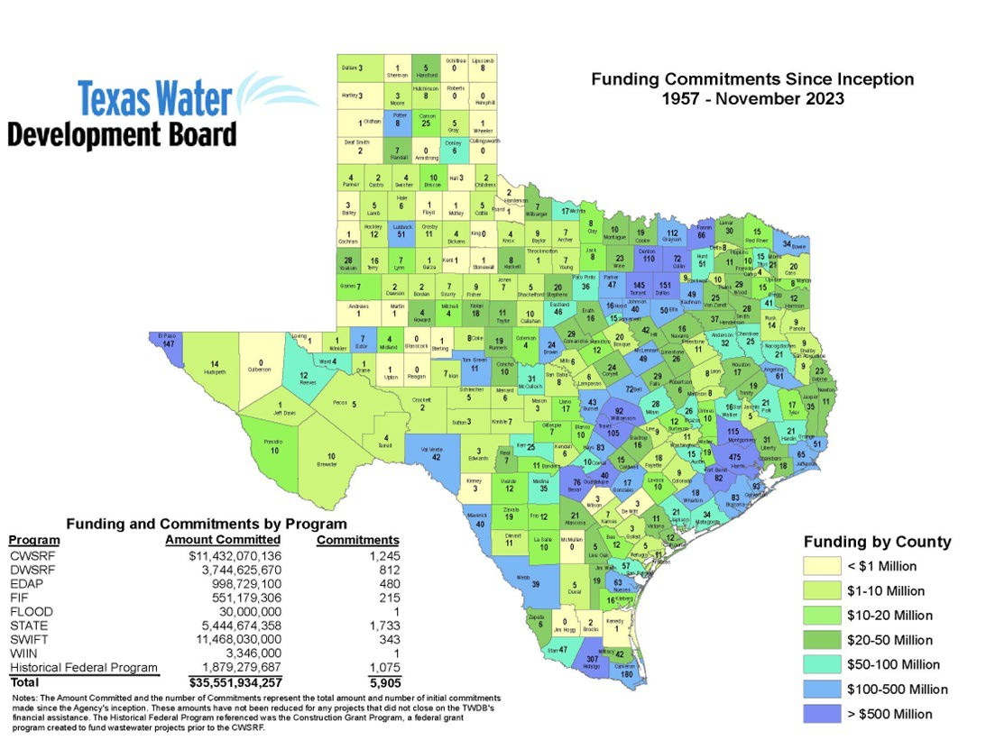
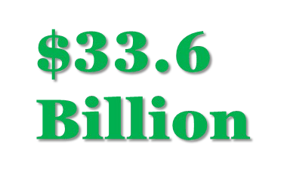
TWDB Funding Commitments

Slide 4
Why?
Dollars Committed and Cost Saving Estimates
Entity Type | Rural | Program | Commitment | Savings
District | No | CWSRF | $ 440,000,000 | $ 10,310,512
City | Yes | CWSRF | $ 65,000,000 | $ 757,523
District | Yes | DWSRF | $ 13,000,000 | $ 4,835,176
District | Yes | DWSRF | $ 6,925,000 | $ 1,616,089
District | No | Flood | $ 10,486,000 | $ 3,944,400
City | Yes | Flood | $ 3,284,000 | $ 1,471,308
City | Yes | SWIFT | $ 14,500,000 | $ 22,032,994
WSC | Yes | WDF | $ 600,000 | $ 99,980
City | No | WDF | $ 28,790,000 | $ 105,567

Slide 5
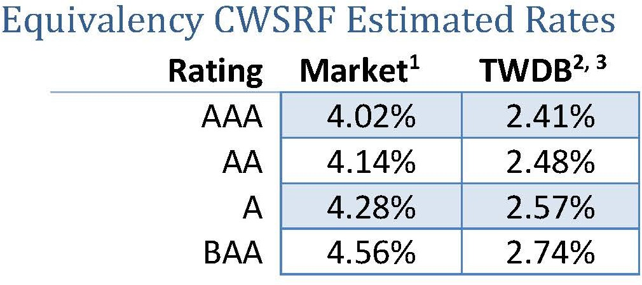
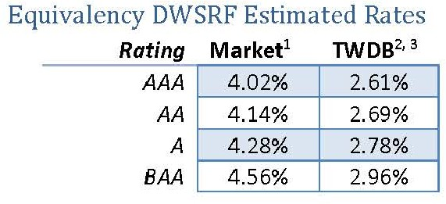
Illustrative Lending Rates
CWSRF 30-year Term DWSRF 30-year Term
General Obligation Programs

Slide 6
Examples of Eligible Projects
Current Water Needs
Future Water Needs
Water Transmission & Distribution
Potable Reuse
Wastewater Collection
Water and Wastewater Treatment
Non-Point Source Pollution Control
Flood Control & Storm Water Management
Irrigation Systems Improvements
Demonstration and Technology Transfer
Equipment Cost Share

Slide 7
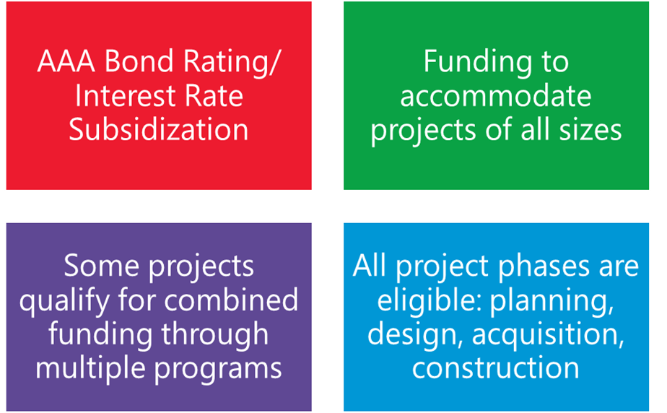
Funding Program Key Points

Slide 8
Texas Constitutional Amendment - Proposition 6
"The constitutional amendment creating the Texas water fund to assist in financing water projects in this state.“
TEXAS VOTERS APPROVED
78% YES
Senate Bill 28
Created the Texas Water Fund, New Water Supply for Texas Fund, and the Statewide Water Public Awareness Account.
Senate Bill 30
Authorized a one-time, $1 billion supplemental appropriation of general revenue to the Texas Water Fund, contingent on enactment of SB 28 and approval of SJR 75 by voters.
Senate Joint Resolution 75
Proposed constitutional amendment creating the Texas Water Fund to assist in financing water projects in Texas
Directed the TWDB to allocate no less than 25 percent to the New Water Supply for Texas Fund ($250 million).

Slide 9
Texas Water Fund (SB 28)
Allows the TWDB to transfer money to certain existing TWDB financial assistance programs.
TWDB must ensure that a portion of the money is used for:
water infrastructure projects for rural political subdivisions and municipalities with a population of less than 150,000
projects for which all required state or federal permitting has been substantially completed
water conservation strategies
water loss mitigation projects
the statewide water public awareness program
Created to provide financial assistance to develop water supply projects that create new water sources for the state, including
desalination projects, including marine and brackish water desalination
produced water treatment projects
aquifer storage and recovery projects
the development of infrastructure to transport water that is made available by these types of projects

Slide 10
Program Administration
Federal Programs
Clean Water State Revolving Fund (CWSRF)
Assists communities by providing low-cost financing for a wide range of wastewater, stormwater, reuse, and other pollution control projects
Emerging Contaminants funding available
Drinking Water State Revolving Fund (DWSRF)
Assists communities by providing low-cost financing for a wide range of water projects that facilitate compliance with drinking water standards
Lead Service Line Replacement funding
Emerging Contaminants
Small Disadvantaged Communities funding
CWSRF and DWSRF - Asset Management Program for Small Systems (AMPSS)
Provides funding assistance to small water and wastewater utilities to create and implement asset management plans and other management tools
Water Utilities Technical Assistance Program (WUTAP)
Provides technical assistance to entities what have never applied to the TWDB or how have submitted requests but have not been invited to apply.

Slide 11
State Programs
State Water Implementation Fund for Texas (SWIFT)
Provides low-cost assistance for projects in the State Water Plan
Bonds for the program are issued through SWIRFT
Funding amount is determined each prioritization round
Economically Distressed Areas Program (EDAP)
Provides financial assistance in the form of grants and loans for water and wastewater projects in economically distressed areas where service is unavailable
Flood Infrastructure Fund (FIF)
Provides financing in the form of grants and 0% loans for drainage, flood mitigation, and flood control projects under four project categories.
Texas Water Development Fund (DFund/WDF)
State loan program that provides financing for water, wastewater, and flood control
TWDB sells bonds for amount needed
Agricultural Water Conservation Loan & Grant Programs
Provides financial assistance for agricultural water conservation projects in Texas
State Participation (SP)
Goal is to allow for the “right sizing” of projects in consideration of future needs. The program encourages the optimum development of regional projects by funding excess capacity for future use.
Rural Water Assistance Fund (RWAF)
Provides small, rural water utilities with low-cost, long-term financing for water and wastewater projects
TWDB sells bonds for amount needed

Slide 12
For SRF, SWIFT, EDAP, and FIF Programs: Applicant submits to the Intended Use
Plan/Prioritization List
Financial Accounting and Loan Repayment
Project Goes Through Planning, Acquisition, Design, and Construction phase
Applicant hires Consultants (Engineer, Financial Advisor, and Legal Counsel)
Delivery Date – Applicant receives financing
Closing Process
For SRF, SWIFT, EDAP, and FIF Programs: Invitations sent to those above funding
line
TWDB Board Consideration/Approval of Application
Pre-application Conference
Applicant submits Financial Assistance Application
12

Slide 13
Intended Use Plan Process
Project Solicitation
SRFs: December 1 – March
1 (each year)
Rating & Ranking Process
March - May
TWDB
Prepares Draft IUP
- Early Summer
Public Comment Period
Summer
TWDB
Adopts Final IUP
Late Summer
/Early Fall

Slide 14
Regional Water Project Development
APPLICATION INTAKE
PROJECT ELIGIBILITY REVIEW
CREDIT ANALYSIS
EXECUTIVE ADMINISTRATOR RECOMMENDATION
BOARD COMMITMENT
LOAN CLOSING
PROJECT IMPLEMENTATION

Slide 15
Outlays and Escrows
Responsible for Disbursement of funds for projects
Outlays: Entities must provide evidence of costs incurred on projects
Escrow Releases: Recipients account where TWDB funds are deposited at closing but can only be released with TWDB approval
Disbursement Methods
Federal programs with principal forgiveness: released based on outlays provided
Program funds can be released either with outlays or completion of project milestones.

Slide 16
Timelines - State Fiscal Year 2024
Program |  | Solicitation Open | Application Deadline
Clean Water State Revolving Fund | $460M | 12/15/2023 - 3/1/2024
Drinking Water State Revolving Fund | $435M
Emerging Contaminants (CWSRF) Lead Service Line Replacement (DWSRF) Emerging Contaminants (DWSRF) | $9.7M $146M $609M | 12/15/2023 - 4/1/2024
Asset Management Program for Small Systems | $100K in services | 9/18/2023 | 11/2/2023
Water Utilities Technical Assistance Program | $150K in services | 11/17/2023 | 1/31/2024
State Water Implementation Fund for Texas (water plan projects over next 50 years) | $27B | 12/7/2023 2/1/2024
Flood Infrastructure Fund (flood plan projects 2024-2025) | $375M | 12/15/2023 | 4/15/2024
Economically Distressed Areas Program (2024-2025) | $100M | 3/15/2024 5/15/2024
Texas Water Development Fund | Bond sell as needed | Spring | 12/31/2024
Blue Text Federal Program. Black Text State of Texas Program.

Slide 17
Helpful Tip
Financial Audits
Are they up to date?
At the time of full application submittal, a current audit is required for the application to be deemed administratively complete.
Costs can be captured in project budget.
Ability to Take on Debt
Analysis will be completed.
What rates and charges are in place? Will they need to be raised?
Updated Water use Survey and Water Loss Audit.
Water Conservation and Drought Contingency Plan (if applicable).
Talk early and often with TWDB staff – we are happy to provide guidance and support

Slide 18
Resource Links
New Texas Water Fund
https://www.twdb.texas.gov/financial/programs/twf/index.asp
TWDB Financial Assistance Programs
https://www.twdb.texas.gov/financial/index.asp
TWDB Financial Assistance Program Guidance Manuals and Forms Library
https://www.twdb.texas.gov/financial/instructions/index.asp
TWDB Funding Application FAQ
https://www.twdb.texas.gov/financial/applications/faq.asp
Clean Water State Revolving Fund Program
www.twdb.texas.gov/financial/programs/CWSRF/index.asp
Drinking Water State Revolving Fund Program
www.twdb.texas.gov/financial/programs/DWSRF/index.asp

Slide 19
Resource Links
Regional Water Planning
www.twdb.texas.gov/waterplanning/index.asp
Flood Programs
https://www.twdb.texas.gov/flood/index.asp
Conservation
https://www.twdb.texas.gov/conservation/index.asp
Texas Water Infrastructure Coordination Committee (TWICC)
https://twicc.org/resources/doc/TWICC_Funding_Resources_Guide.pdf
*
TWDB Newsletter
https://www.twdb.texas.gov/newsmedia/signup.asp

Slide 20
For more information
Visit https://www.twdb.texas.gov/financial/index.asp Or email: financial_assistance@twdb.texas.gov
Stay connected:
20

Slide 21
Charging the Future: The Role of Retail in Our EV Transition
Drew Toher Consumer Reports April 5, 2024

Slide 22
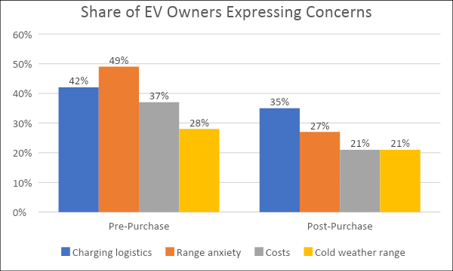
Consumer Concerns with EV Charging
Charging logistics:
–One of the most commonly selected barriers among consumers who have not purchased an EV
– The most persistent problem among EV owners
Source: “Electric Vehicle Owners,” Consumer Reports nationally representative survey of 943 respondents (February 2023), https://article.images.consumerreports.org/image/upload/v1679253682/prod/content/dam/surveys/Consumer_Reports_EV_Owners_October_November_2022.pdf; only top four responses displayed.

Slide 23
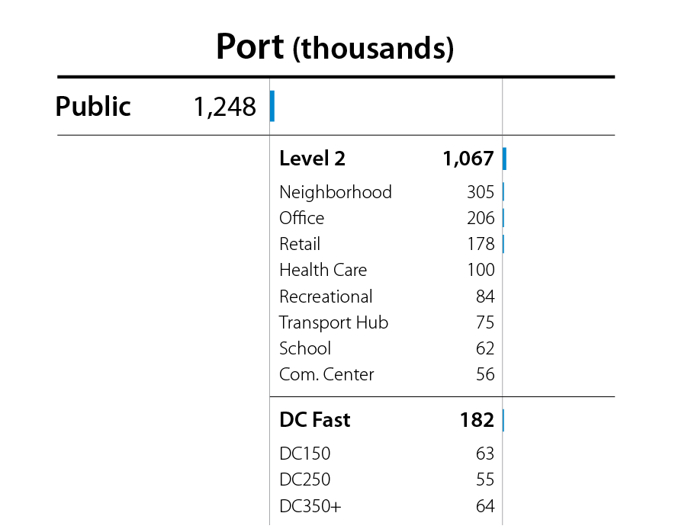
America’s Charging Challenge
1.25 million chargers needed by 2030 to meet consumer demand
Roughly 10% of this goal is currently built out
Data from CR community reflects the national challenge
Source: Wood et al., “The 2030 National Charging Network: Estimating U.S. Light-Duty Demand for Electric Vehicle Charging Infrastructure,” National Renewable Energy Laboratory, June 2023, https://www.nrel.gov/docs/fy23osti/85654.pdf.

Slide 24
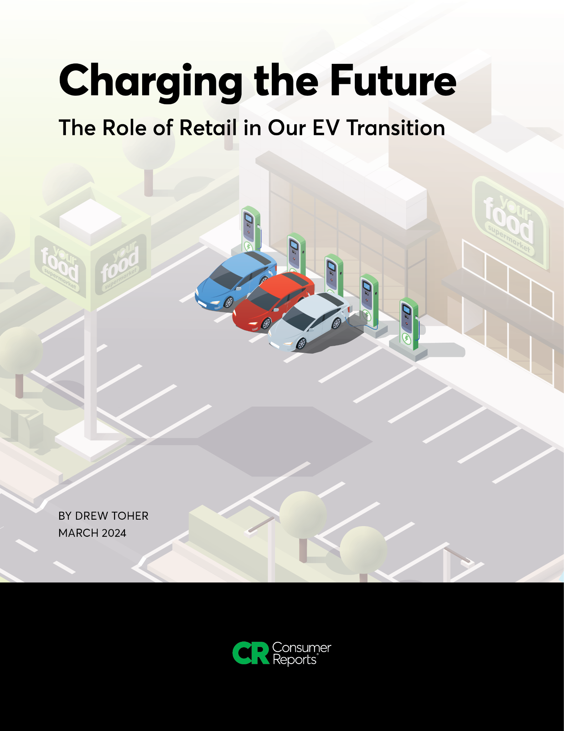
Solution: More Chargers Where Consumers Want Them
Key Findings:
Almost all retailers are lagging
Out of 270,000 stores reviewed, only about 1% offer EV charging
Ikea only retailer to cover nearly all store locations
Room for improvement and big opportunity for companies that invest
Read the report here: https://advocacy.consumerreports.org/research/cr-report-charging-the-future-the-role-of-retail-in-our-ev-transition/

Slide 25
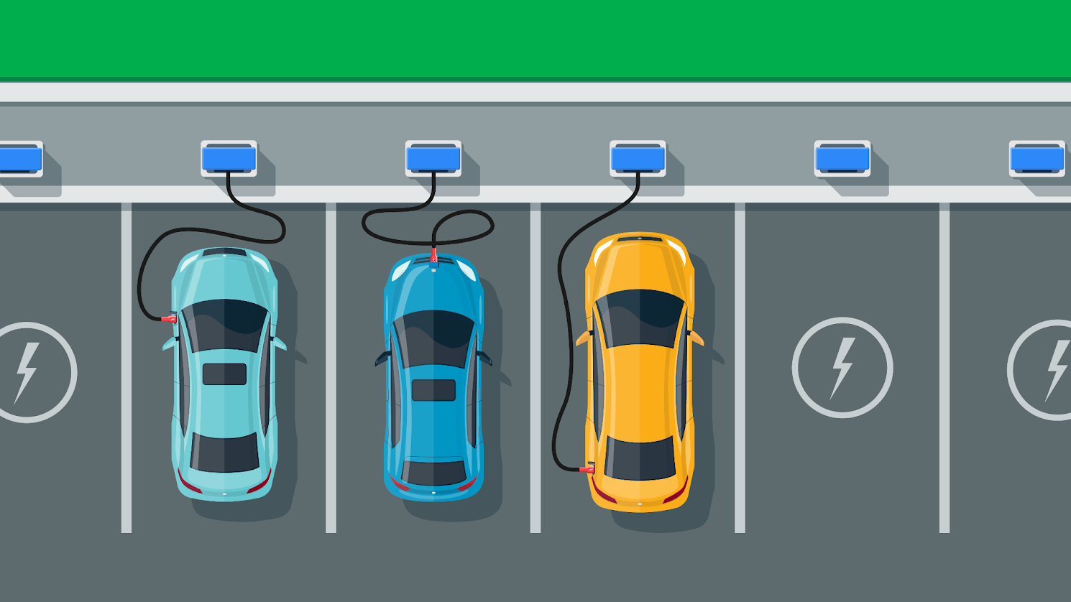
Strong Business Case
Economic Benefits of Charging for Retailers:
Increase in foot traffic (4%)
Increase in revenue (5%)
More time spent at store location (average upwards of nearly 1 hour)
High chance of a retail purchase (89% buy something while charging)
Free charging can act as a loss leader, fast charging provides direct revenue
Cost offsets through solar and battery backup
Read the report here: https://advocacy.consumerreports.org/research/cr-report-charging-the-future-the-role-of-retail-in-our-ev-transition/

Slide 26
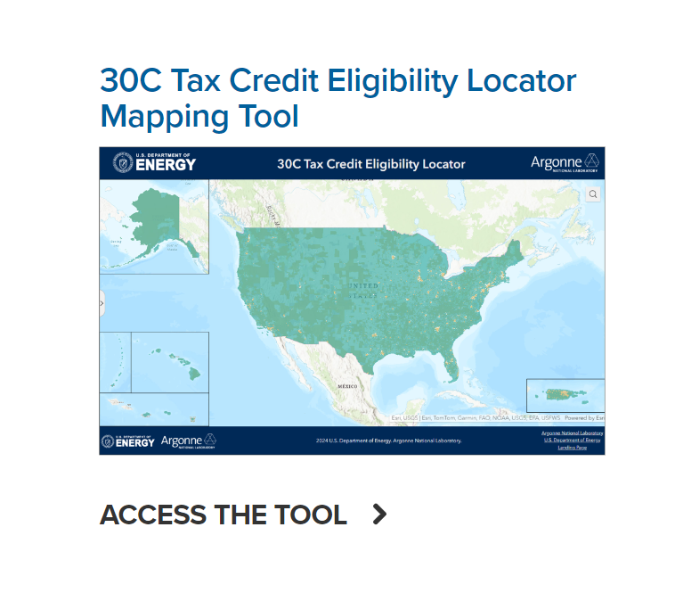
Federal Incentives Available
Federal Programs Retailers Can Tap Into:
Inflation Reduction Act
Provides credit of 30%, up to $100,000 for charger installation
Available for underserved communities (covers roughly ⅔ of U.S.)
Bipartisan Infrastructure Act
Community and Highway EV Charging Grant Programs
Retailers can partner with local governments to access funding
Source: “Refueling Infrastructure Tax Credit,” Argonne National Laboratory, 2023, https://www.anl.gov/esia/refueling-infrastructure-tax-credit.

Slide 27
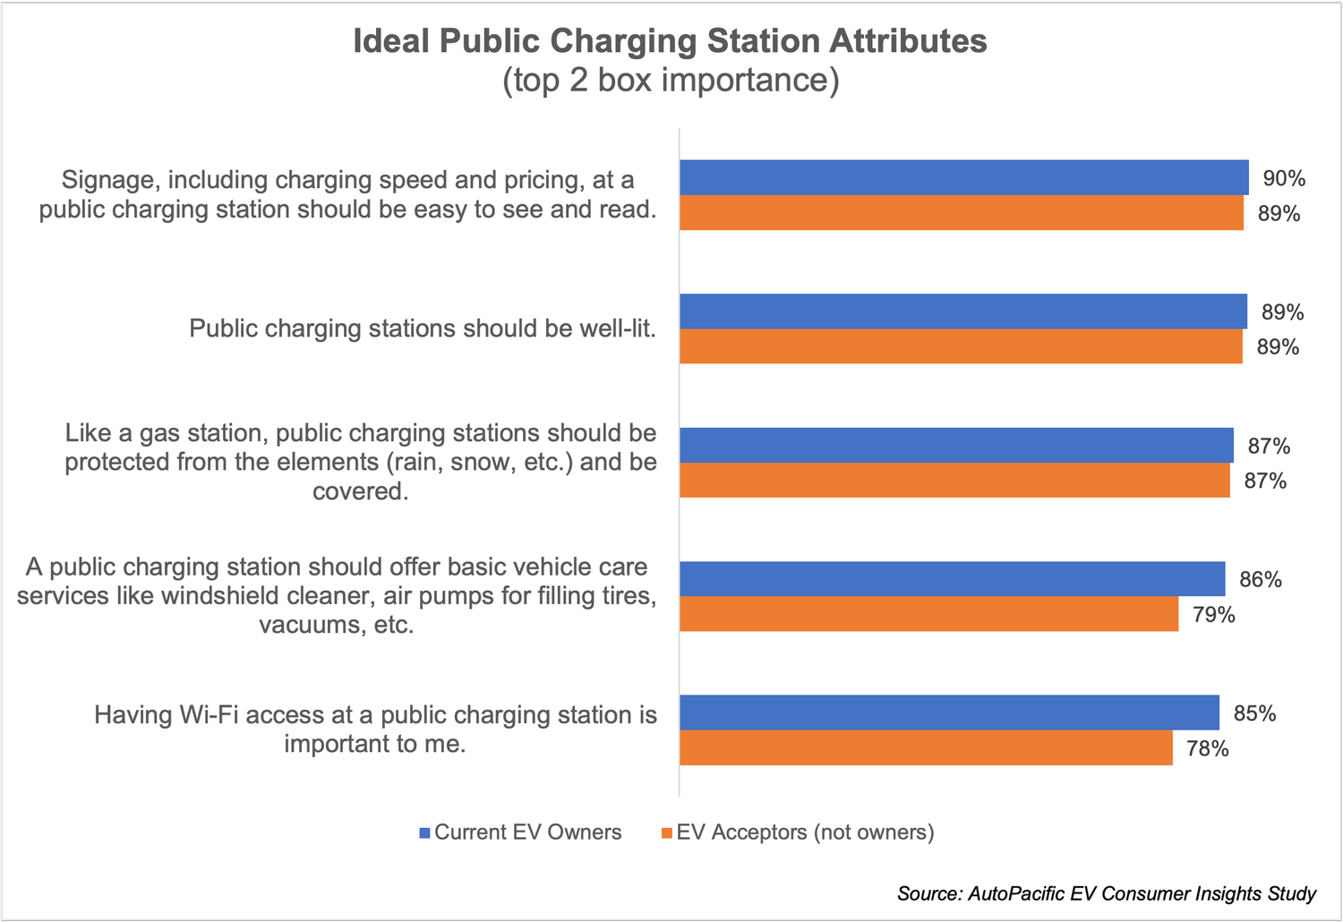
Which Retailers Will Benefit?
First movers in an area
Retailers that associate their brand with charging
Those who best meet consumer needs for reliability, speed, amenities, and safety
Source: “Autopacific Ev Consumer Insights Study” https://www.autopacific.com/autopacific-insights/2024/2/14/autopacific-study-reveals-ev-consumers-want-a-public-charging-experience-similar-to-that-of-traditional-gas-stations

Slide 28
CR’s Campaign to Expand Retail Charging
Which specific grocery and big box chains should install more EV charging?
Take our action
Collecting stories on retail EV charging
What does charging access at a retailer mean for you?
Help show retailers the value EV charging brings to their customer
Charging Insights Panel
Real-time feedback on charging station reliability

Slide 29
Thank you TxETRA!

